Slide 1

You can be the best chef
Flook

Slide 2
You can be the best chef

Slide 3
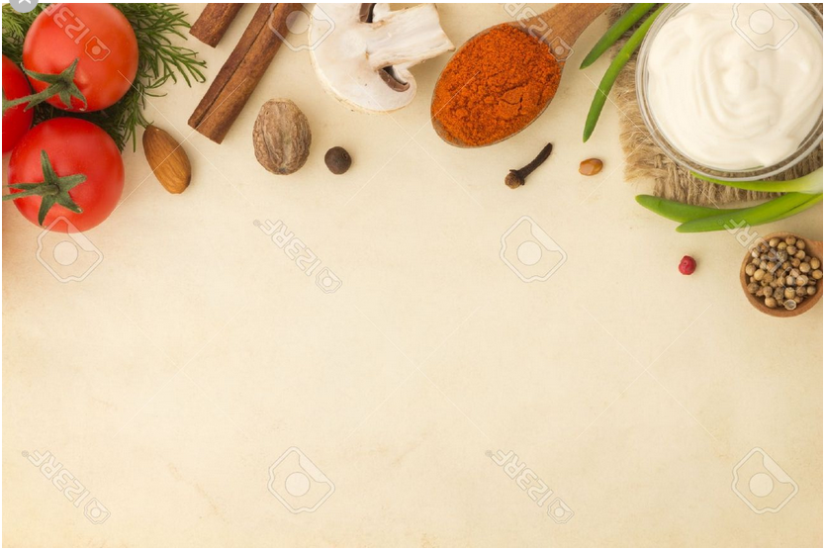

Slide 4
